Slide 1
GROUP 11 PRESENTATION
MATLAB

Slide 2
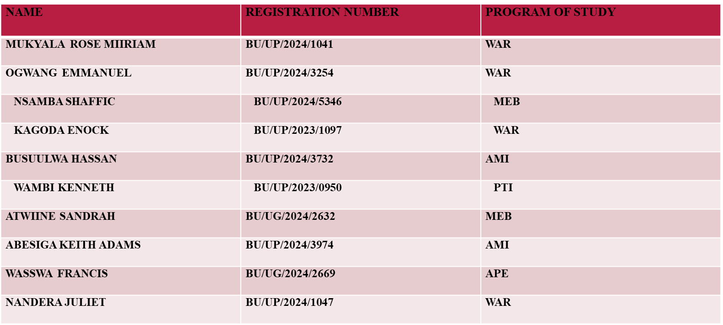
MEMBERS

Slide 3
Background.
MATLAB has a rich history of being used for numerical approximate methods of solving differential equations and functions. The software’s capabilities date back to its early development, leveraging numerical methods that were already being explored and developed

Slide 4
KEY FEATURES OF MATLAB FOR NUMERICAL METHODS METHODS
.
Ordinary Differential Equations (ODEs)solvers: MATLAB provides built-in functions like ode23 and ode45 for solving ODEs, which utilize Runge-Kutta methods of different orders. These solvers are designed to handle various types of ODEs and provide accurate approximations.

Slide 5
NUMERICAL INTERGRATION: MATLAB offers several methods for numerical integration, including trapezoidal rule and Simpson’s rule, which can be used to approximate definite integrals.

Slide 6
POLYNOMIAL REGRESSION: The software allows users to perform polynomial regression, which is useful for curve fitting and approximating functions.

Slide 7
METHODOLOGY
DEFINITION.
We identified the challenge given to us and went ahead to do research. We identified different kinds of differential equations and functions that we could solve numerically. This helped us to determine the type of differential equations to deal with and the desired level of accuracy.

Slide 8
CHOOSING A NUMERICAL METHOD
WRITING THE MATLAB CODE
TESTING AND VALIDATING THE CODE
VISUALIZATION AND INTERPRETATION OF THE RESULTS.

Slide 9
PRACTICAL_EXAMPLE_1(PROJECTILE MOTION) .
Suppose we throw a ball from height 20m with velocity 20m/s, equation for height h(t) = 20+40t-6t^2
%h(t) = 20 + 40t - 6t.^2, find when h(t)=0
clc; clear; close all;
s = @(t) 20 + 40.*t - 6.*t.^2;
% function
ds = @(t) 40 - 12*t;
%derivative for Newton
tic

Slide 10
%---Bisection Method---
[a, b] = deal(0, 10); %search interval
tic
root_bisect = bisection(s, a, b, 1e-6, 100);
time_bisect = toc;
%---Newton-Raphson method---

Slide 11
root_newton = newton(s, ds, 2, 1e-6, 100);
time_newton = toc;
fprintf('---Root Finding (Projectile)---\n');
---Root Finding (Projectile)---
fprintf('Bisection root: %.6f s (time %.6f s)\n', root_bisect, time_bisect);
Bisection root: 7.133918 s (time 0.017705 s)
fprintf('Newton root: %.6f s (time %.6f s)\n',root_newton, time_newton);
Newton root: -0.467251 s (time 0.010991 s)

Slide 12
% Plot the function
t_vals = linspace(0, 5, 200);
figure;
plot(t_vals, s(t_vals), 'b-', 'LineWidth',2);
hold on;
yline(0, 'k--');

Slide 13
plot(root_bisect,0,'ro','MarkerSize',8,'MarkerFaceColor','r');
plot(root_newton,0,'gs','MarkerSize',8,'MarkerFaceColor','g');
legend('s(t)','Ground (y=0)','Bisection root','Newton root');
xlabel('Time (s)');
ylabel('height (m)');
title('Projectile Motion Root Finding');

Slide 14
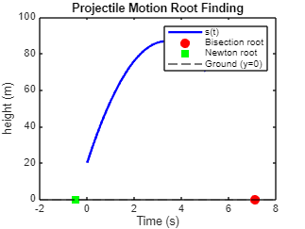

Slide 15
Conclusion.
The height the ball attains increases with time until when it reaches its maximum height and thus the time it takes to reach the ground can be calculated.

Slide 16
PRACTICAL_EXAMPLE 2, ODE SOLVING (COOLING PROBLEM)
Consider Newton's law of cooling; T(t) = Troom + (To - Troom)e.*-kt
% dT/dt = -k(T-Tr),T(0)=90, Tr=25, k=0.07
k = 0.07; TO = 90; Tr = 25;
f_ode = @(t, T) -k.*(T - Tr);
tspan = 0:1:60; % time steps (minutes)
%--- Euler Method ---
tic

Slide 17
T_euler = euler(f_ode, tspan, TO);
time_euler = toc;
%--- RK4 Method ---
tic
T_rk4 = rk4(f_ode, tspan, TO);
time_rk4 = toc;
%--- Analytical Solution ---
T_exact = Tr + (TO - Tr).*exp(-k*tspan);

Slide 18
fprintf('\n--- Cooling Problem (ODE) ---\n');
--- Cooling Problem (ODE) ---
fprintf('Euler time: %.6f s\n', time_euler);
Euler time: 0.010338 s
fprintf('RK4 time: %.6f s\n', time_rk4);
RK4 time: 0.017171 s

Slide 19
% Plot solutions figure;
plot(tspan, T_exact, 'k-', 'LineWidth',2);
hold on;
plot(tspan, T_euler, 'ro--');
plot(tspan, T_rk4, 'bs-');

Slide 20
legend('Exact','Euler', 'RK4');
xlabel('Time (min)');
ylabel('Temperature (oC)');
title('Cooling Problem Comparison');
grid on;

Slide 21
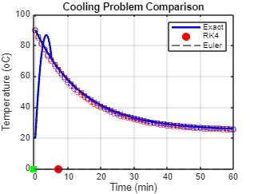

Slide 22
Conclusion.
This plot confirms the exponential nature of the cooling process, and the effects of varying parameters such as temperature of the room, initial temperature and the cooling constant which can be easily observed.

